Slide 1


Slide 2


Slide 3
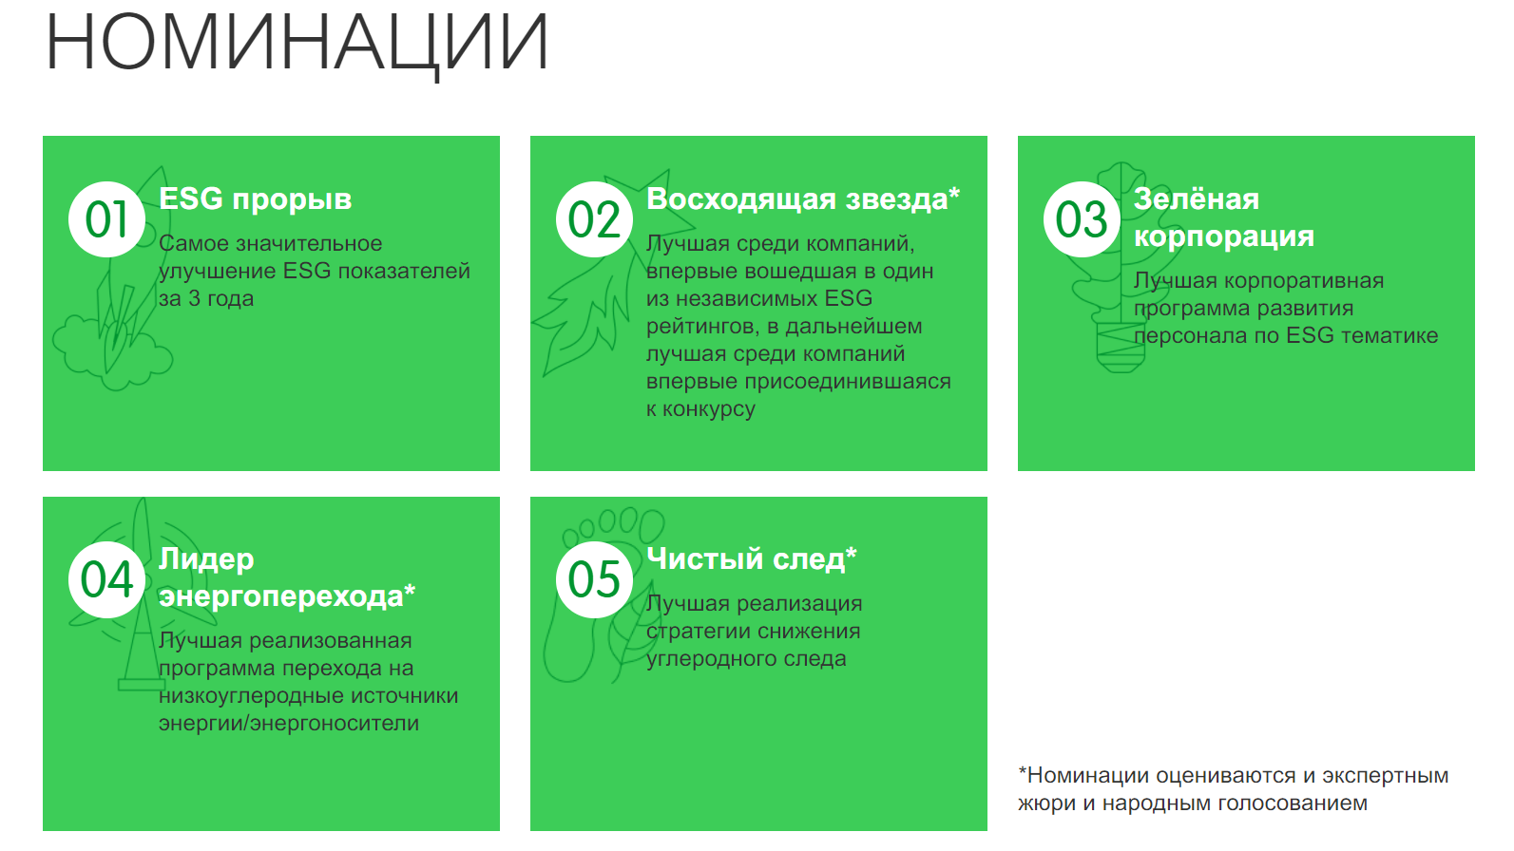

Slide 4
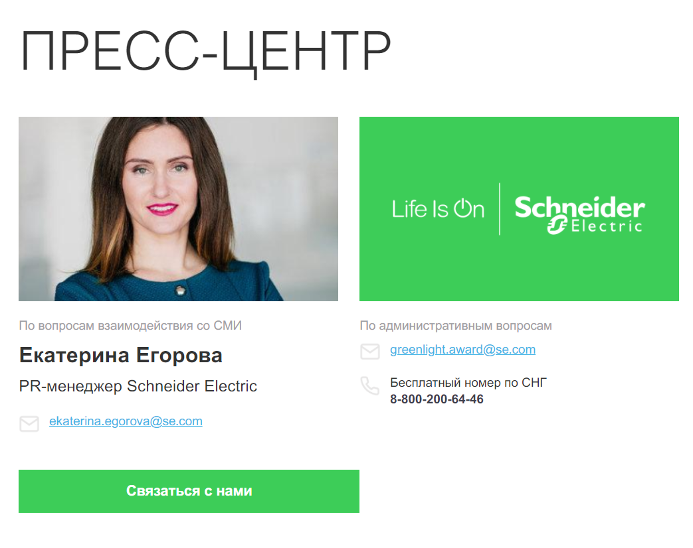
https://se.greenlight-award.ru/

